Slide 1
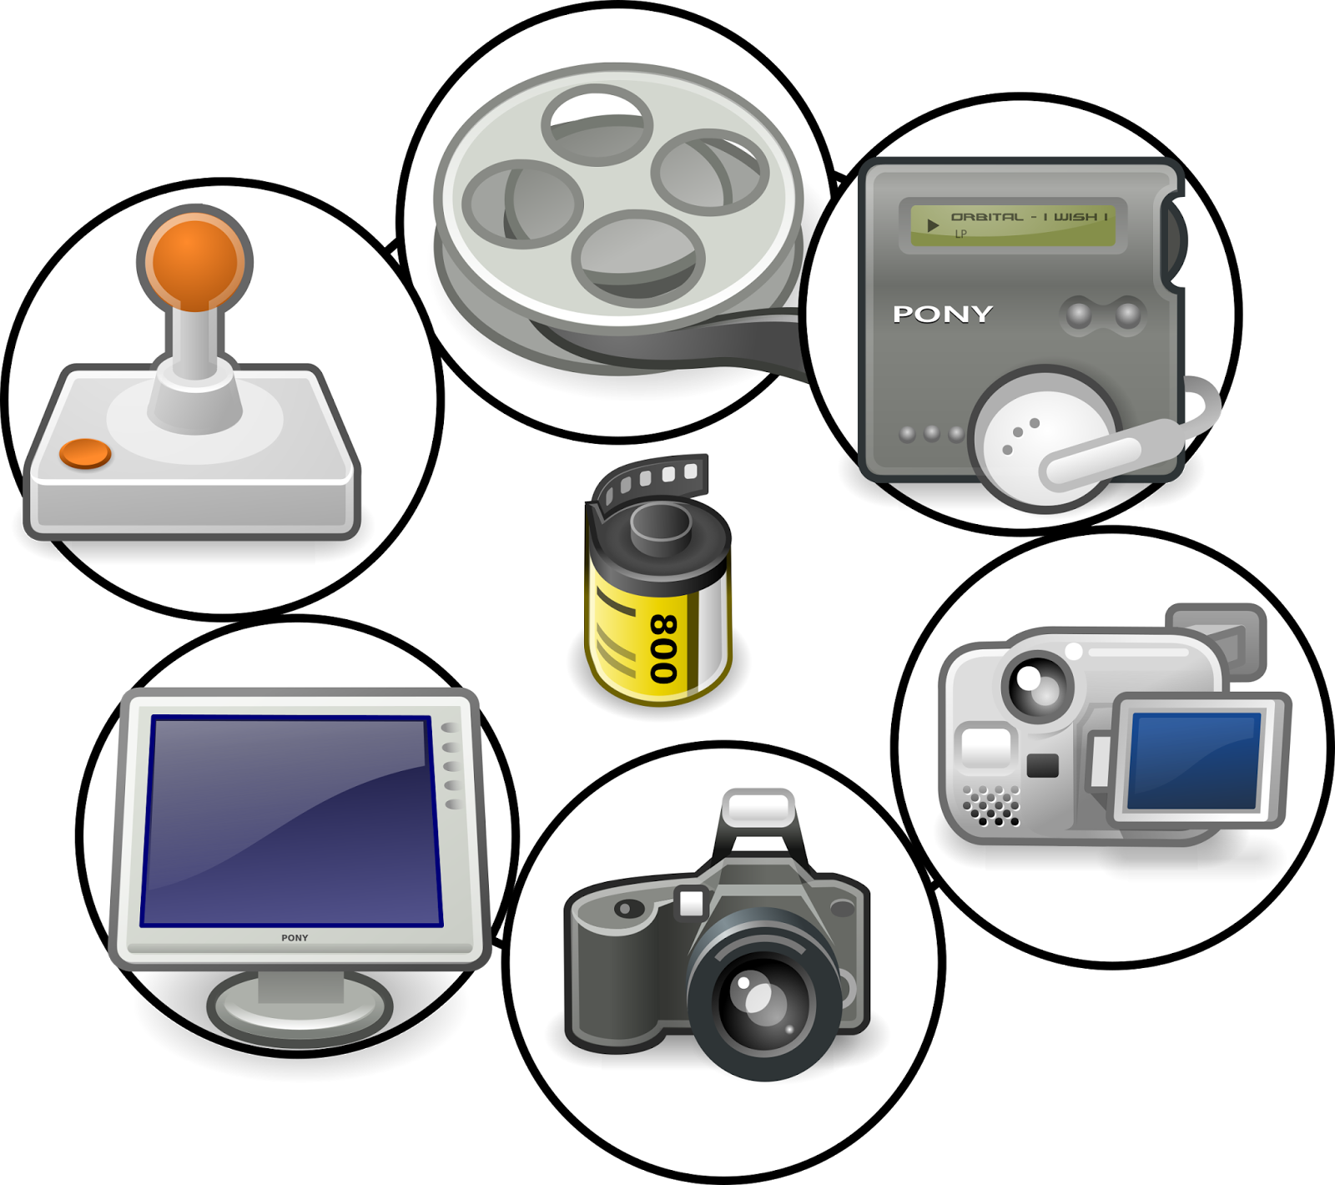
Understanding Multimedia Elements
Defining Key Components: Text and Fonts, Animation, Video, Graphics, Photos, Audio, and Music
This Photo by Unknown Author is licensed under CC BY-SA

Slide 2
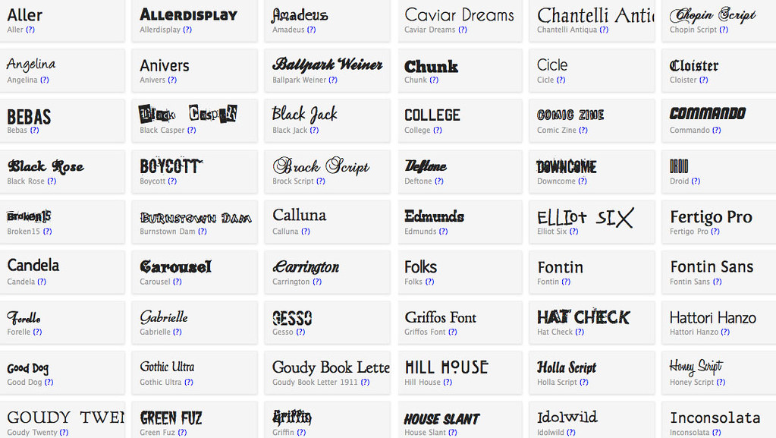
Text and Fonts
Text is a fundamental element in multimedia that conveys information and engages the audience.
Fonts are crucial as they affect readability, tone, and emotional response. Types of fonts include:
- Serif: Traditional and formal (e.g., Times New Roman)
- Sans Serif: Modern and clean (e.g., Arial)
- Display: Creative and decorative fonts for impact.
This Photo by Unknown Author is licensed under CC BY

Slide 3

Animation
Animation brings multimedia to life by creating motion and transitions. It enhances storytelling and engagement. Types of animations include:
- 2D Animation: Traditional and vector-based animations.
- 3D Animation: Adds depth and realism to animations.
- Motion Graphics: Combines graphics and animation for visual storytelling.

Slide 4

Video
Video is a powerful multimedia element that combines moving images with sound to convey messages.
Key aspects of video include:
- Frame Rate: Determines the smoothness of motion.
- Resolution: Affects clarity and detail (e.g., 1080p, 4K).
- Compression: Reduces file size while maintaining quality.

Slide 5

Graphics
Graphics are visual representations that enhance the communication of ideas. They include:
- Illustrations: Hand-drawn or digital art.
- Infographics: Combine data visualization with graphics.
- Logos: Brand identifiers that encapsulate company identity.

Slide 6

Photos
Photos capture real-life moments and convey emotions. They play a vital role in multimedia by:
- Telling stories visually.
- Evoking emotions and responses.
- Providing context and background.

Slide 7

Audio
Audio enhances multimedia presentations by adding sound effects, narration, or background music. It includes:
- Sound Effects: Used to create atmosphere and enhance realism.
- Voiceovers: Narration that explains or guides.
- Background Music: Sets the tone and mood of the presentation.

Slide 8

Music
Music is a crucial element in multimedia that influences emotions and audience engagement. Key points include:
- Genres: Different styles evoke different feelings (e.g., classical, pop).
- Licensing: Understanding copyright and usage rights is essential.
- Integration: Music should complement visuals without overpowering them.

